Slide 1
Techno-Economic Analysis for ARPA-E Performers
Alex Luce

Slide 2
Agenda
  Motivation
    Techno-Economic Analysis (TEA) is essential tool for ARPA-e team & Performers
  Background: Current TEA activity at ARPA-e
    Process is currently ad-hoc and fragmented
    Several models already exist in certain areas
  Scope of Work
    Research energy technology archetypes
    Streamline process for creating TEAs
  Outcomes
    Providing best-practices and templates for technology archetypes.
    Provide program-specific TEAs as examples
Notes:
Project descriptions should have already been provided; you can also find them under P: Technology-to-Market/Internships 2013/Project Descriptions.

Slide 3
Executive Summary
  Motivation
    Techno-Economic Analysis (TEA) is essential tool for ARPA-e team & Performers

Slide 4
Proposed Video Modules
Background: What is a TEA and how is it used?
Getting Started: How to build a TEA for the first time
  Checklist: Steps before you start modeling
  Assumptions
  Process flow diagram
Best Practices for a useful model
  Gathering information
  Dealing with uncertainty
  Incorporating feedback
Using your model to inform technical and business decisions
  Basic sensitivity analysis
  real-life examples

Slide 5
Table of Contents
(hyperlinked to sections)
Background:
  What is Techno Economic Analysis
  How is Techno Economic Analysis used at ARPA-E?
Getting Started: How to build a TEA for the first time
  Checklist: Steps before you start modeling
  Assumptions
  Process flow diagram
Best Practices for a useful model
  Gathering information
  Dealing with uncertainty
  Incorporating feedback
Using Techno Economic model to inform technical and business decisions
  Basic sensitivity analysis
  real-life examples
Appendix and Resources

Slide 6
What is techno economic analysis?
Background

Slide 7
Techno Economic Analysis (TEA)
Connects Research Outcomes to Relevant Economic Factors
More than a Cost Model, not a business plan
Inherently challenging and interdisciplinary
Low Fidelity at Start of Project → Increasing Fidelity as Project Advances
Identify specific technology improvements that affect major cost drivers
Determine economic viability of end product
Notes:
Identify specific technology improvements that affect major cost drivers.
Determine economic viability of end product

Slide 8
Techno Economic Analysis
can also be known as:
Manufacturing cost
Process design and analysis
Systems cost analysis
Lifecycle cost analysis
Technical cost modeling
Nomenclature and modeling specifics will depend on type and stage of problem being considered.
Source: NREL, Technology Systems and Sustainability Analysis Group

Slide 9
Techno Economic Analysis
Overarching principals:
  Defined by ultimate market goal
  Achieve consistency in credibility and objectivity
  TEA should be discussed – look at entire ecosystem
  TEA should capture risk
  Assumptions need to be transparent and credible
1. Getting first significant digit close is challenge
2. It is OK to say: we don’t know ‘X,Y,Z’ at this time
Source: Internal Analysis & NREL, Technology Systems and Sustainability Analysis Group

Slide 10
Example TEA: Solar PV Panel
…at the end of the day it’s all about LCOE (the cost of electricity produced)
Key Metric:
$/watt → …LCOE
System costs:
$/m² (cell components) + $m² (hardware components) + $/kW (inverter)
/system lifetime
Unknowns:
Degradation, temperature coefficient
Manufacturing processes
Cost of raw materials and labor
Installation, permitting
Taxes
Now
$1/watt
(goal)
TEA goes beyond cost modeling by connecting research outcomes to economic factors

Slide 11
Basics of a technical cost/performance model
Technical Cost Modeling combines cost modeling with physical process models
Example:
External
Inputs
Predicted
Parameters
Cost & Performance Outputs
Part Size
Material
Volume/yr
Gas Composition
Deposition Rate
Equipment Utilization
Material Costs
Energy Costs
Equipment Costs
Performance Metrics
Design tradeoffs affect both cost and performance
Source: Szekeley, JOM (1996) http://www.tms.org/pubs/journals/jom/9612/szekely-9612.html

Slide 12
TEA modeling interrelationships
Requires several interconnected models
Techno economic analysis
Performance
Cost
Financial
chemical
mechanical
bill of materials
Market
electrical
structural
operations
Capital
capital
Source: Dan Matuzak
Multi-scale, systems model,
Connects: physical performance to production, operation cost

Slide 13
How ARPA-E Performers use TEA models
Study system-level impacts of technical details
Integrate calculations together for holistic consideration
Identify cost, performance drivers → steer research
Communicate results with stakeholders
  Internal: R&D, Management, Marketing
  External: Industry Advisors, Investors, Customers, Licensing Partners
Crucial tool for technical and business decision making
Notes:
-We talked a bit about cost modeling, trying to turn a profit in future; important to you now because it enables R&D
-Each individual calculation may be simple, the real value comes in bringing them all together into one place, efficiently study system-level impacts of technical details
-Most importantly, will identify cost drivers, use this to guide research; best use of your time when addressing cost and performance simultaneously
-Communicate with stakeholders: convince research team members; something concrete to talk about when checking your understanding with industry advisors; know the value so you can negotiate effectively with investors, customers, licensing partners; compelling case for next funding opportunity
-Mature tech companies use cost modeling extensively; once you have it you’ll never stop using it

Slide 14
TEA use at ARPA-E depends on program stage
Pre-FOA
FOA
Negotiations
Award Period
Program scoping:
Does this make sense?
Practical implications
If we do this- will it matter?
What ideas to actually focus on?
Pitch - program justification
Program criteria
FOA targets
Evaluate proposals:
Will this hit FOA target?
Compare applications relative to each other
Establish scientific and technical milestones
Develop high-fidelity tech-specific model
Inform technical and business decisions
Keep performers on track
early
Program Stage
advanced
Notes:
Consider Updating

Slide 15
TEA evolution during award period
Technical Risk
Full financial
company model
How do we make money?
Advanced stage
20% of teams get here
Process cost model
  Resources required to produce at scale?
  10-20 tab version
  80% of teams
Cost/performance model
Key drivers?
Block diagram –
process flow
simple, 1-2 tabs
All teams
Model Fidelity
Basic BOM
Ingredients?
link to performance data or predictions
0
12
Award Period (months)
24
36
Notes:
Process: Determine resources (and $$) required for at-scale production/operation; Tabulate material/component flow, labor & energy use, equipment, etc

Slide 16
TEA is a discussion tool
Building model is iterative and scientifically driven process
ARPA-E
Program Directors
T2M Team
Provide feedback, insight, industry knowledge
Critical review of model
Sounding board for assumptions
Guidance and comparison
Significant costs?
Performers
PI’s, Scientists, Biz Dev
Build model to inform technical and business decisions
Validate numbers through discussion with industry
Begin to establish supplier relationships
Evaluate impact on potential purchasing decisions
TEA enables focused dialog regarding technology and cost drivers
  Scientifically driven approach: collecting data, defining variables,
  quantifying uncertainty, testing hypotheses.
Notes:
Scientific aspect: collecting data, defining variables, quantifying uncertainty, building a model.

Slide 17
What currently exists?
Resources, examples, state of the art

Slide 18
Methods of manufacturing cost estimation
Traditional methods can’t forecast cost of new designs, materials, or architectures
Type | Description | Used | Fidelity | Ease of use | ARPA-e Suitable | Resources
Traditional Cost Accounting | indirect cost = (arbitrary %)*direct cost | General accounting, all over, outdated
Cost of Ownership (COO) | per piece of equipment, per lifetime of equipment | Intel, Sematech, microelectronics industry
Activity Based Costing (ABC) ¹ | Identify direct and indirect cost of production activities; Allocate cost per activity | Management accounting; large firms
Technical Cost Modeling ² | Couple descriptive cost model + predictive technical model | Materials production: process/product oriented
Process Based Cost Modeling (PBCM) ^{3,4} | Maps technology description to process cost | Operations research, mfc./ process optimization
0th Order, Research Approach ⁵ | 1) Consider implications for materials targets, performance tradeoffs; build iterative model. | Internally, ad-hoc
*
*
* Dependent on maturity, assumptions, and stage.
Source: 1) Kaplan and Burns (1987), 2) Szekeley (1997), 3) Field (2007), 4) Fuchs (2010), 5) Gur (2014)
Notes:
Traditional: http://en.wikipedia.org/wiki/Indirect_costs#Indirect_vs_direct_costs
Szekeley: http://www.tms.org/pubs/journals/jom/9612/szekely-9612.html
Field: http://ardent.mit.edu/real_options/RO_current_lectures/ESD%2003%20Slides/ProcessCostModel03.pdf

Slide 19
TEA model landscape
Size of bubble = applicability to multiple teams
Transformational
(ARPA-e relevance)
= ARPA-E = others
High
Electrofuels
model
early-stage
performer models
METALS
calculator
Example
production cost model
REMOTE
calculator
NREL SAM
Process-based
cost model
Argonne Li-ion
battery model
MIT PV Cost Calc.
Investment financial models
NREL Biorefinery
(Aspen Plus)
Low
Fidelity
Low
High

Slide 20
Process Based Cost Modeling
Makes connection between technical changes and production cost
Stage 1
Stage 2
Stage3
Process Model
Operations Model
Financial Model
Steps
Inputs
Technology Description
Processing Requirements
Operating Conditions
Resource Requirements
Factor Prices
Productions Cost
Outputs
Inform technical decisions before investments are made
Source: Source: Erica Fuchs, Randolph Kirchain, Frank Field

Slide 21
Process of building TEA
Generic mfc. “widget” production
Research approach - 0th Order
  Done for mature technology
  Little value for early-stage tech
Current resources:
  Process-Based Cost Modeling
“Big complex model adapted for a small system”
  What are implications for materials targets, performance tradeoffs, etc.??
  Scientific aspect:
  Collect data, define variables, quantify uncertainty
“Few resources exist”
Performers with early-stage technology will likely be taking the 0th Order Research Approach, its scientifically driven approach.

Slide 22
Best Practices

Slide 23
Modeling techniques: cataloging variables and assumptions
Project Assumptions
Performance variables
Cost assumptions
Manufacturing assumptions
Dimensionality
Physical Constraints
materials
Yield
physics
thermodynamics
chemicals
Utilization
chemistry
equipment
biology
labor

Slide 24
Collecting/Estimating Prices
Illustrative example
Price
Here we see that the price of a material or chemical can vary wildly depending on where the information is obtained. Pay attention to the inherent uncertainty of prices obtained via different sources.
Example | Commodity Prices | Sigma-Aldrich | Alibaba | Lux Research | Academic/ Technical Literature | Vendor | Vendor
Price inputs have varying accuracy and use depends on model stage.
Notes:
start with raw materials, add multiplicative factor, then sigma aldrich, then volume pricing, then market research, published work, then vendor quotes, then negotiated prices
specialty

Slide 25
Dealing with uncertainty
Concern:
  “It’s too early—there is too much uncertainty to determine what this would cost”
Modeling still beneficial:
  Make uncertainties explicit
  Identify most valuable improvements
  Develop targets, metrics
  Bound with theoretical limits
  Create thought framework for reducing uncertainties
Max
Baseline
+
Min
Cost
Performance
Notes:
-Possible concern: “It’s too early”
-Still beneficial—start simple, and with a little bit of homework get a pretty decent ballpark estimate, that might be enough to indicate what to work on
-See what information you are missing, figure out what you need to know
-Within the framework, see the relationships among all the pieces, improve your understanding of the technology and its uses

Slide 26
Dealing with uncertainty : sensitivity analysis
Focus on attacking the right problem
High priority
Low priority
Use iterative approach to refine model

Slide 27
Contribution of processing and materials costs
Is your product driven by processing costs or materials costs?
Cost breakdown mix determines TEA development
Process-
Driven
Device-
Driven
100%
eg. power, chemical industries
eg. widget production, fully-optimized manufacturing
Other
Utilities
BOM
BOM = Bill of Materials; Utilities= water, gas, electricity; Other= everything else incl: processing, labor, equipment, etc..
Sources: 1) METALS calculator tool; 2) REMOTE calculator tool; 3) Argonne National Lab; 4) MIT PV Cost Calculator; 5) Display Search Intl.

Slide 28


Program technology archetype categorization
All TEA’s will have common steps as a starting point
Chemical processing, refining
Energy intensive
Materials and process streams,
mass/energy balance
Constructing hardware, systems, devices
Materials intensive
Discrete components, systems integration
Process-
Driven
Technologies
Device-
Driven
Technologies
Common Steps
Objective: what problem are we solving?
Constraints and boundary conditions
Process flow block diagram
Materials, Labor, Energy, Equipment for each step
Understand and quantify uncertainty

Slide 29
TEA checklist
Before you even open excel
Define the scope of problem |  | Diagram the problem |  | Sanity Check
 |  |  |  | (with T2M Advisor)
Clearly defined question that the model seeks to address? Yes Boundaries defined to limit scope of problem? Yes Assumptions are clearly stated? Yes Key variables? Are defined Have confidence interval High, low, baseline values based on data, literature. System performance: Model Predicted results Experimental results |  | Draw a process flow diagram Yes Draw material flows into AND out of each step: Yes Catalog for each step: Equipment (Q) Labor (L) Energy (E) Expected process yield? Best guess Empirical data Are there any waste streams? Yes No |  | Confirm Assumptions Do assumptions make sense? Resources What informational resources are needed? Can you use analogs from existing work, other sectors/industries? Hypothesis Clearly stated

Slide 30
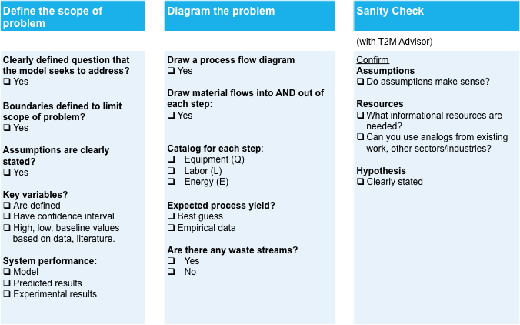
Why use a checklist for TEA development?
Short, limited to critical steps only…
Takeaways
Break down complex tasks
steer towards simplicity
expected minimum steps
Knowledge sharing
take time to document common processes
memory recall
Accountability
culture of accountability and transparency
Checklist impacts many aspects of project including collaboration, communication, and quality of output
N Engl J Med 2009
Notes:
Figure 4 The WHO Surgical Safety Checklist was tested in eight hospitals in eight different countries, representing both resource-rich and resource-poor populations

Slide 31
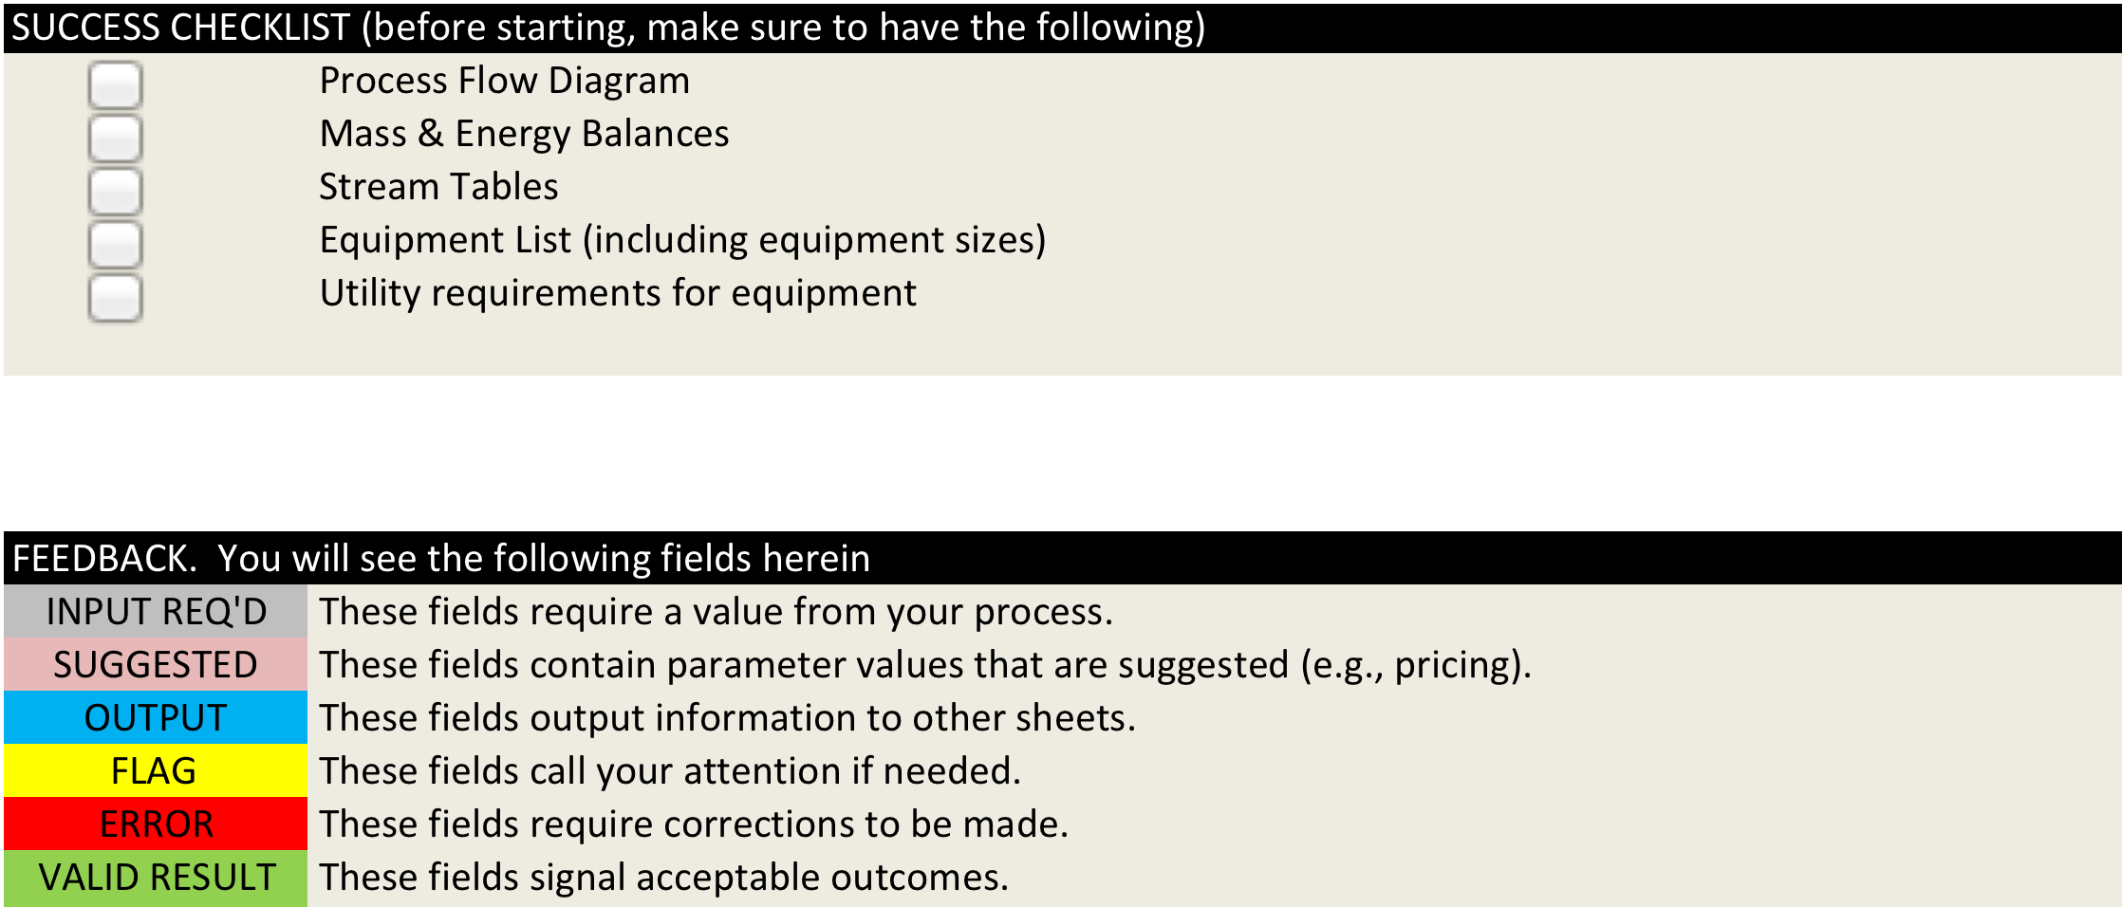
example checklist from METALS TEA
“Lets us avoid walking in the dark with performers…”
Made available for all teams during program inception
Standard method, assumptions, vocabulary
Allows for apples-to-apples comparison of teams
Source: METALS_toolv1.xls
Notes:
“Tech SETA’s don’t have time to scrutinize all the stream tables, etc…”

Slide 32
TEA evolution during award period
Be as smart as possible along every step of the way
Check:
financial assumptions
Technical Risk
Check:
Mfc., waste, yield, utilization
Check:
Process-flow diagram,
mass/energy balance
Check:
Basic
Assumptions
Full financial
company model
Advanced stage
20% of teams get here
Process cost model
  Resources required for producing at scale?
  10-20 tab version
  80% of teams
Model Fidelity
Simple cost/performance model
Block Diagram –
process flow
simple, 1-2 tabs
All teams
Basic BOM
link to performance data or predictions
0
12
Award Period (months)
24
36

Slide 33
Conclusion

Slide 34
Performer Toolkit
BOM & Sensitivity Analysis
Process & Production
Cost Modeling
Resources, Examples, and Bibliography
Cost/Performance
Sensitivity Tool
Manufacturing
Production Line
Current Best Practices
Process Flow
Opex
Parameters
Bill of Materials
Consequences
(Inputs)
Output
Process Step
(Outputs)
(2) Capex
Parameters
Cost &
Performance
Summary
Enable better assumptions, test hypothesis
Resources needed to build product
Knowledge base for performers and ARPA-e team

Slide 35
Conclusion and recommendations
Process of building TEA is beneficial…
… but there are significant challenges
“Reduces technical uncertainty limits to private sector investment”
-ARPA-E
“Can enable first market opportunities before ultimate program goal”
-ARPA-E
“Can help teams learn ‘bad news’ sooner”
-ARPA-E
“We’re glad you forced us to do this”
-Performer
“We’re a startup with limited bandwidth, we need to focus on research”
-Performer
“Few resources exist”
-ARPA-E
“Its too early to think about cost”
-Performer
“I had no idea where to get started;
Google wasn’t exactly helping”
-Performer
In sum: TEA is an essential tool, but need to continually address possible roadblocks

Slide 36
APPENDIX

Slide 37
Proposed Video Modules
Background: What is a TEA and how is it used?
Getting Started: How to build a TEA for the first time
  Checklist: Steps before you start modeling
  Assumptions
  Process flow diagram
Best Practices for a useful model
  Gathering information
  Dealing with uncertainty
  Incorporating feedback
Using your model to inform technical and business decisions
  Basic sensitivity analysis
  real-life examples

Slide 38
Cost Analysis
Production
Performance Analysis
Waste
Stream
Bill of Materials
Requisite Operating inputs:
eg. Fuel/Energy
Efficiency, Lifetime, Capacity Factor
Material/energy
utilization efficiency
OpEx
Utilities
Labor
Rent
Technology Operating
Performance Characteristics
Unit
Production Cost
Cost of Goods Sold (COGS) $
CapEx
Useful Work/Energy
Output
Waste
Energy/heat
Equipment
Machinery
Facilities
Relevant Performance Metric
(power, energy, etc.)
Operation
$ Operating inputs:
eg. Fuel/Energy
Unit Operating cost
$ Resources for at-scale operation
COGS ($)
Figure of Merit =
Performance

Slide 39
Process of building TEA
Generic mfc. “widget” production
  Done for mature technology
  little value for early-stage tech
“Big complex model adapted for a small system”
Current resources:
  . Process-Based Cost Modeling
Research approach - 0th Order
  What are implications for materials targets, performance tradeoffs, etc.??
  Scientific aspect: collecting data, defining variables, quantifying uncertainty, building a model.
Few resources exist

Slide 40
Bibliography

Slide 41
Collecting/Estimating Prices
Process modeling has yielded metrics that can be priced (warehouse square footage, gold usage per day, etc.)
Depending on the sophistication of your cost model, you will need varying accuracy in your price inputs.
Try to understand the variability inherent in estimating prices
Market Reports and Vendor Discussions
Free
Internet Sources
Vendor Quotes
Negotiated Prices
Notes:
start with raw materials, add multiplicative factor, then sigma aldrich, then volume pricing, then market research, published work, then vendor quotes, then negotiated prices
graph uncertainty, illustrative example wawterfall

Slide 42
Remarks to performers
Get started modeling cost early, and refine as knowledge advances
  guess as placeholder to get framework in place (and make note of it)
  work on larger factors first (getting first significant digit right is a challenge)
Use, manipulate, and adapt the template spreadsheet to suit your needs, but
  be guided by its scope (deliberate)
  don’t dodge necessary considerations because of difficulty to validate or seemingly unfavorable results
Full business financial model (cash flow, debt, timing, etc.) also needed before pitching for external financing (not shown here)
Send any cost modeling questions & comments to your ARPA-E Tech-to-Market Advisor

Slide 43
Background: Basic Cost Modeling
A simple cost model can be a useful starting point for building a Techno Economic Analysis.
  Incorporates Technical Information About Process
  Builds Cost Up From Technical Detail
  Must Be Able To Address Cost Implications Of Change In
    Product Design or
    Process Operation -- Including Production Volume
  Purpose Of A Cost Model Is To Inform Technical Decisions

Slide 44
What is Cost Modeling?
Inputs
COST
MODEL
Costs
Recipes
Procedures
Raw Material Prices (est.)
Energy Prices (est.)
Labor Prices (est.)
+ Assumptions!
Operating Cost
  Raw Materials
  Labor
Capital Cost
“Fully-Loaded” Cost
Source: Cost Modeling, Chiverton

Slide 45
Example Cost Model: Solar PV Panel
What would this product cost?
Key Metric:
$/watt
System cost:
$/m² (cell components) + $m² (hardware components) + $/kW (inverter)
/ system lifetime = ____ $/watt
Now
$1/watt
(goal)
A simple cost model is a methodology to convert what is known about a product or production process and estimate what the product will cost to produce at scale

Slide 46
Levels of Performer Cost Modeling
Basic bill of materials (BOM)
    What goes into my technology?
Block diagram of production process
  How is it made?
Production cost model
  What resources are required for producing at scale?
Full financial company model
  How do we make money and run a business?

Slide 47
Cost Modeling Process Overview
Identify potential cost drivers
Specify functional forms
Find analogous systems
Collect data
Normalize data

Slide 48
1. Identify potential cost drivers
  Determine what causes the cost of each element
    Reach out to experts: government, industry, trade associations.
    Distill major cost drivers:
      Technology
        Equipment/production yields, automation, analogs.
        New, high-risk technology is generally more expensive
      Size
        Eg weights, volume, watts, quantity, etc.
        Generally, bigger is more expensive.
      Performance
        Speed, resolution, throughput, reliability.
        Greater performance usually comes at higher cost.

Slide 49
2. Specify functional form
What will it look like?
Functional form should make sense
Get engineering opinions if possible

Slide 50
Steps to Create Process-Based Cost Model
Define Question To Be Answered
Refine Model Boundaries
Diagram Process Operations & Material Flows
Relate Cost To What Is Known
Understand Uncertain Characteristics

Slide 51
Selecting Analogous Systems
An analogous system will have a similar cost driver and similar functional form when mapped to the cost.
Look for systems that smell, taste, and look like the items you are estimating.
  Example: using flat panel LCD technology to model advanced electro-optic devices for solar
In reality, there may be few systems that employ similar technology, performance, and size – use judgement.
Don’t overly constrain yourself when selecting analogous tasks.

Slide 52
Collecting Data
Select systems relevant to the system being costed
  Does cost data exist for any compenets you are using?
  Or choose analogous systems or components
Typical cost drivers include physical and performance characteristics:
  Physical characteristics: weight, volume, number of holes drilled, number of parts to assemble, materials and precursor selections, etc.
  Performance characteristics: power, thrust, bandwidth, range, speed, capacity, etc.
Historical improvements in technology are an important consideration
  Know your industry: trends, macro-drivers, change in composition as technology evolves (eg. Increasing percentage of composite materials used in place of metals)

Slide 53
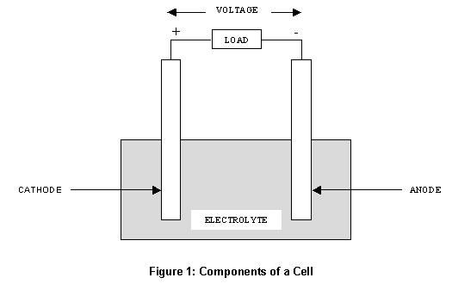
Basic bill of materials (BOM)
  What goes into my technology?
Simple Battery Example
Anode
Cathode
Separator
Electrolyte
Housing

Slide 54
Basic bill of materials (BOM)
  What goes into my technology?
Simple Battery Example
Anode
Cathode
Separator
Electrolyte
Housing
A bill of materials is a list of items needed to build a product correctly.

Slide 55
TEA Examples
Biorefinery (NREL)
  http://www.nrel.gov/extranet/biorefinery/aspen_models/
  Includes TEA excel spreadsheets
Li-Ion Battery Cost-Performance Model (Argon) BatPac
  http://www.cse.anl.gov/batpac/index.html
Solar PV
  Crystalline silicon cost model paper and excel files: http://pv.mit.edu/tma/

Slide 56
5 M’s of Manufacturing
Materials
Manpower
Methods
Machines
Measurements
+rate, quantity, efficiency.

Slide 57
Fundamental Cost Tradeoffs in Production
Development | Material | Fabrication | Assembly
Time & Complexity Sharing among related systems Novelty vs. incremental refinement | Raw materials cost Ability to reuse scrap and process materials Properties and performance Purity of materials used and level of processing required | Feasible geometries and complexity Final product properties Rates of production, utilization, loss, defects, rework Tooling & equipment requirements | Number of parts Diversity of processes and materials Rates of production, loss, defects, rework Tooling & equipment requirements
Source: Field, JOM (2007)

Slide 58
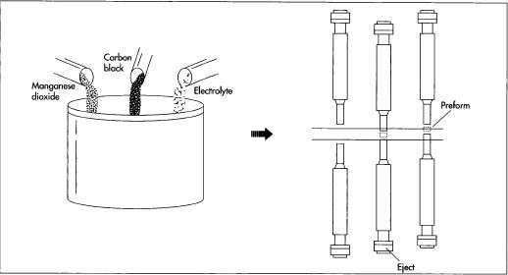
Block diagram of production process
How is it made?

Slide 59
To understand cost development the industry structure needs to be understood
Example: Li-Ion battery supply chain overview*
Anodes
Cathodes
Co
Cathode materials
Copper foil
Anode
Cobalt
Aluminum Foil
Binder
Cell/Battery Makers
End-product makers
Separator
Electrolyte Solution
Separator manufacturers
Electrolyte Solution
Electrolyte
Adapted from: Roland Berger "LIB value chain cost model"

Slide 60
Cost Analysis
Production
Performance Analysis
Waste
Stream
Bill of Materials
Requisite Operating inputs:
eg. Fuel/Energy
Efficiency, Lifetime, Capacity Factor
Material/energy
utilization efficiency
OpEx
Utilities
Labor
Rent
Technology Operating
Performance Characteristics
Unit
Production Cost
Cost of Goods Sold (COGS) $
CapEx
Useful Work/Energy
Output
Waste
Energy/heat
Equipment
Machinery
Facilities
Relevant Performance Metric
(power, energy, etc.)
Operation
$ Operating inputs:
eg. Fuel/Energy
Unit Operating cost
$ Resources for at-scale operation
COGS ($)
Figure of Merit =
Performance

Slide 61
Price – COGS = Gross Margin
Definitions
Price – What the market pays
COGS – Cost of Goods Sold
  Materials
  + Depreciation
  + Labor
  + Other
COGS the full cost to manufacture your product
  includes materials, depreciation, labor, other costs and is impacted by yield, utilization
BOM – Bill of Materials, applies to single unit
Note: Materials ≠ BOM
COGS

Slide 62
COGM = Cost of Goods Manufactured
COGM
Material Cost

Slide 63
Production Cost Analysis
This section includes materials, labor, and production requirements for the technology.
Waste
Stream
1.
Bill of Materials
Material/energy
utilization efficiency
CapEx
Equipment
Machinery
Facilities
2.
Production/Mfc.
Process Flow
COGS ($)
3.
/amortization
OpEx
Utilities
Labor
Rent
4.

Slide 64
Bill of Materials (BOM)
A list of “ingredients,” or raw materials, chemicals, and components needed to assemble a product.
Bill of Materials
Simple Battery Example
Actual Numbers
Anode
Cathode
Separator
Electrolyte
Housing
Cell Materials Costs
Positive Electrode, $/kg
Active material |  |  | 10.00
Carbon |  |  | 6.80
Binder PVDF |  |  | 10.00
Binder Solvent (NMP) |  |  | 3.20
Negative electrode material, $/kg
Active Material |  |  | 19.00
Carbon Black |  |  | 6.80
Binder |  |  | 10.00
Binder Solvent |  |  | 0.00
Positive current collector foil, $/m² |  |  | 0.80
Negative current collector foil, $/m² |  |  | 1.80
Separators, $/m² |  |  | 2.00
Electrolyte, $/L |  |  | 21.60
Source: Argonne BatPac v2.0, default values

Slide 65
Bill of Materials (BOM)
A list of “ingredients,” or raw materials, chemicals, and components needed to assemble a product.
Bill of Materials
Cost Information Sources
Low
Raw material costs (lower bound)
Bulk chemical pricing
Data from reports
Direct supplier research
Vendor discussions for major costs
Actual cost data for projected volumes from specific potential supplies
Direct quote/purchase order
Negotiated contract from vendor
Fidelity
High
Key is to start early and develop iteratively with best available information
CAUTION: Prices for laboratory quantities are much higher than for the commercial quantities that you would use for plant design economic calculations.

Slide 66
Bill of Materials (BOM)
Bill of Materials
Types of Materials (illustrative example)
Low
Raw
Processed
Fully
Processed
Elements
Proteins
Grains
Embodied Energy
Chemicals
Parts
Discrete devices
Formed metals
High
Embodied energy should be taken into account when analyzing materials costs.

Slide 67
Process Flow Diagram
Capture the entire production process in easily understood format
Process Flow
  Descriptive step names and step-wise material inputs and outputs
  Establish modeling level of detail: each step to receive its own treatment in production model
  Overall inputs and output define position in value chain
LEGEND
(Material Inputs)
(Stage Number): (Stage Name)
(Stage Output)
Example: sandwich production line
Flour
Water
Yeast
Salt
PROCESS BLOCK DIAGRAM
Herbs
1: Make Dough & Form Buns
Raw Buns
2: Bake Buns
Buns
Cheese
4: Assemble Sandwiches
Cold
Sandwiches
5: Toast & Test
Toasted Sandwiches
Meat Block
Sliced Meat
3: Slice Meat
Source: Sandwich Production Model Template, Stooke

Slide 68
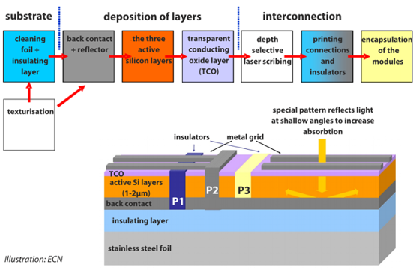
Process Flow Diagram
Capture the entire production process in easily understood format
Process Flow
  Descriptive step names and step-wise material inputs and outputs
  Establish modeling level of detail: each step to receive its own treatment in production model
  Overall inputs and output define position in value chain
Example solar cell manufacturing process
Source: Sandwich Production Model Template, Stooke

Slide 69
Capital Expenditure (CapEx)
CapEx
Cost to acquire or upgrade physical assets such as equipment, property, or industrial buildings
What equipment and infrastructure to do I need to run my process?
Simple Battery Example
Capital equipment cost including installation, mil$ |  |  |  | 133
Building, Land and Utilities
Area, m² |  |  |  | 15,928
Cost, $/m² |  |  |  | 3,000
Building investment, mil$ |  |  |  | 47.8
Capital Equipment, million$ |  |  |  | 40
Source: Argonne BatPac v2.0, default values

Slide 70
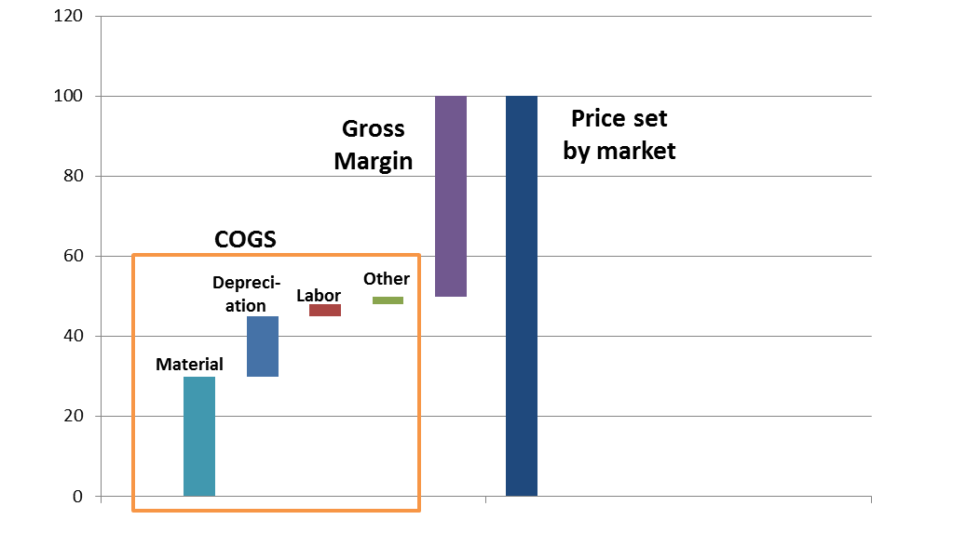
Depreciation = amortized CapEx
The spreading out of capital expenses for assets over a specific time period time (the asset's useful life)
$250M
$25M
10 yr Term
25M units
$1
Per-unit
Depreciation
Yearly
Depreciation
Factory &
Equipment
(CapEx)
Source: 24M Technologies, Inc. 2012

Slide 71
Operating Expenditures (OpEx)
Ongoing cost to run your factory including utilities, labor, rent, etc.
OpEx

Slide 72
Performance Analysis
Low
Building a Performance Model
Requisite Operating inputs:
eg. Fuel/Energy
Efficiency, Lifetime, Capacity Factor
Can start by making optimistic estimation or performance based on modeling on lab results
Model system physical parameters
Model performance based on changes to those materials
Construct/test prototype
Construct/test pilot demonstration
Test at relevant scale/operating conditions
Make sure you know which performance metrics are valued by the market
  Keep in mind: What is the customer paying for?
Fidelity
Technology Operating
Performance Characteristics
Waste
Energy/heat
High
Useful Work/Energy
Output
Relevant Performance Metric
(power, energy, etc.)

Slide 73
Final Step: Integrate Cost & Performance Models
Benefit of technology = value at cost
 | Material A | Material B
COGS ($) | $750 | $1,000
Energy (kWh) | 2 | 2
Life (cycles) | 3,000 | 10,000
Life cycle cost ($/kWh) | $0.13 | $0.05
Cost Model
Performance Model
Integration

Slide 74
Resources
How do I find chemical/material prices?
How do I determine equipment cost and utilization?
How do I determine labor productivity and wages?

Slide 75
How do I find chemical/material prices?
ChemE departments at Universities have good resources, here are some to start with:
http://people.clarkson.edu/~wwilcox/Design/refcosts.htm
http://guides.library.tamu.edu/content.php?pid=216817&sid=1802700
http://guides.library.cornell.edu/content.php?pid=2816&sid=14269

Slide 76
Appendix

Slide 77
Final Remarks
Get started modeling cost early, and refine as knowledge advances
  guess as placeholder to get framework in place (and make note of it)
  work on larger factors first (getting first significant digit right is a challenge)
Use, manipulate, and adapt the template spreadsheet to suit your needs, but
  be guided by its scope (deliberate)
  don’t dodge necessary considerations because of difficulty to validate or seemingly unfavorable results
Full business financial model (cash flow, debt, timing, etc.) also needed before pitching for external financing (not shown here)
Send any cost modeling questions & comments to your ARPA-E Tech-to-Market Advisor

