Slide 1
Helping You Navigate ARPA-E’s Invoice Process

Slide 2
Table of Contents
Background Overview of Cost Terms
Preparing an ARPA-E Invoice
Contacts and Information Links
ARPA-E’s Invoicing Approach

Slide 3
Overview
ARPA-E’s Responsibilities
Review all incurred costs for: Reasonableness, Allowability, and Allocability
Be available to answer questions and communicate with Performers
Maintain accountability for the expenditure of public funds
Ensure that claimed amounts are used to meet project objectives and goals
Explain problems or discrepancies with invoice submissions
Approve the reimbursement for allowable costs within 30 days
Performer’s Responsibilities
Submit invoices for incurred costs related to the project SOPO, within the award period of performance, and in accordance with the applicable federal regulations
Submit the necessary supporting documentation to allow ARPA-E to determine: Reasonableness, Allowability, and Allocability of invoiced costs
Submit an invoice that is mathematically correct
Respond to questions from ARPA-E within the timeframe provided

Slide 4
Background Overview of Cost Terms
Financial Assistance Awards
Cost Terminology

Slide 5
Financial assistance awards
Grant
Transfers of a thing of value from a federal agency to a recipient to carry out a public purpose without substantial involvement by ARPA-E.
Cooperative Agreement
Transfers of a thing of value from a federal agency to a recipient to carry out a public purpose with substantial involvement by ARPA-E.
Substantial Involvement
Refers to the degree of ARPA-E participation in project decision making, including stage-gate approvals at various times in the project.

Slide 6
Cost terminology
Reasonable Costs
Costs that, in its nature and amount, does not exceed that which would be incurred by a prudent person in the conduct of competitive business.
Allocable Costs
Costs that are assignable to the Federal award or other cost objectives in accordance with relative benefits received.
Allowable Costs
Must be necessary and reasonable for performance
Must be allocable per the cost principles
Must conform to any limitations identified in the award or cost principles
Must be consistent with the Recipient’s practice
Must be afforded consistent treatment
Must be determined in accordance with GAAP
Must be adequately documented
Disallowed Costs
Those charges to a Federal award that are determined to be unallowable in accordance with applicable Federal statues, regulations, or the terms of the Federal award.
Unsupported Costs
Any cost that lacks sufficient documentation to enable a definitive conclusion
Cost Share
Percentage of the total allowable project costs to be provided by the Prime Recipient.
Notes:
Voice Track:
This definition is standard throughout the Government and applies to Grants and Cooperative Agreements
Rule of Thumb – If your organization wouldn’t consider the invoice expense reasonable, don’t invoice ARPA-E for the expense.

Slide 7
ARPA-E’s Invoicing Approach
Invoices are Linked to Project Objectives
Invoice Review Approach

Slide 8
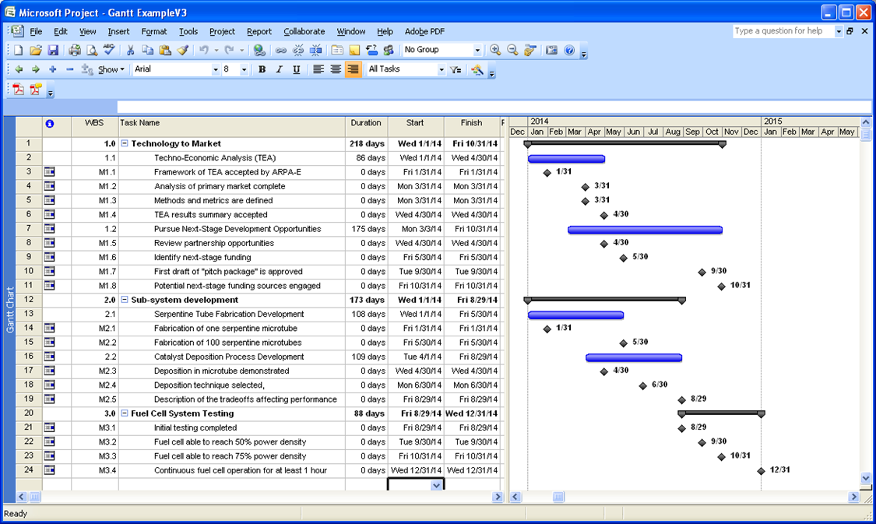
Invoicing is linked to project objectives
Invoices provide additional understanding of a project’s financial performance in relation to task/milestone/deliverable status
Invoices should go hand-in-hand with progress toward the milestones/tasks in the project SOPO
Notes:
Voice Track:
Ensure invoice costs comply with agreed-to-terms in the cooperative agreement, the budget justification, and federal cost principles

Slide 9
ARPA-E’s Invoice Review Approach
ARPA-E will…
Reimburse to the maximum extent possible; based on applicable Federal statues, regulations, and the terms of the Federal award
Reject invoices that are missing or have incorrectly completed required federal documentation (e.g., SF-270)
Reject invoices that are submitted without any supporting documentation
Performers will…
Be responsible for the content and quality of their invoices
Be responsible for the content and quality of their sub-awardees’ invoices
Be responsive to questions and requests for additional supporting documentation
The invoice form (SF-270) states, “I certify that to the best of my knowledge and belief the data on the reverse are correct and that all outlays were made in accordance with grant conditions or other agreement and that payment is due and has not been previously requested.” Invoice submissions are subject to the terms of the False Claims Act (FCA). Performers in violation of the FCA may be subject to criminal and civil penalties.

Slide 10
Preparing an ARPA-E Invoice
Invoice 30-day Timeline
Actions ARPA-E will Take on an Invoice
Preparing an Invoice Submission
Supporting Documentation
Helpful Invoice Preparation Hints

Slide 11
Invoice 30-day timeline
Day 1: Invoice Submission
Day 2-10: Data Input & Financial Review
Day 11- 15: Performer Resolution
Day 16-30: Final Review and Approval
Invoice submission should coincide with organization’s normal billing pattern
Expenses submitted must be relevant to the technical performance of the project for the period being reported
Requests may be submitted no more frequently than every two weeks
Performer submits SF-270 and supporting documentation to both VIPERS and ARPA-E representative
ARPA-E reviews invoice to assess both Performer’s adherence to Government cost principles and progress in meeting established tasks
ARPA-E will issue questions to Performer within ten days
If no questions arise, the invoice will move forward for final review and approval
If questions DO arise, Performer returns follow-up information within the timeframe provided (5 business days)
Final review of all documentation and costs against project budget
Invoice processed through ARPA-E systems
Invoice processed through Oak Ridge Financial Services Center (ORFSC) for payment
ARPA-E will work to meet this notional timeline; we ask Performer teams to partner with us to achieve it.

Slide 12
Actions ARPA-E will take on invoices
Questions
Pay in Full
All supporting documentation was included
Costs claimed are allowable under the award
Will ask questions about cost and/or documentation
Performers are asked to respond within the timeframe provided
Pay in Part
Pay as much of the invoice that is allowable
Reject
Invoice is inadequate
Amount claimed is not supported by source documentation submitted
Performer can address short-paid costs on a future invoice

Slide 13
Preparing an invoice submission
Thoroughly review the cost principles applicable to the project organization
Review the project’s approved SF-424a, Budget Justification, and the Funding Agreement including Attachment 1. Specific areas to review are:
Cost Sharing
Allowable Costs
Indirect Costs
Pre-award Costs
Patents
Payment Procedures
Budget Changes
Collect and review the supporting documentation for the expenses being claimed. The costs should be incurred during the period of performance of the Cooperative Agreement or follow the pre-award cost clause in the terms and conditions
Review the reimbursement request against the final ARPA-E approved budget and prepare the SF-270
Ensure that the math is correct and submit the invoice through VIPERS and directly to ARPA-E support personnel.
SF-270 federal and cost share amounts must tie to the invoice supporting documents submitted. If they do not, ARPA-E may reject the invoice.

Slide 14
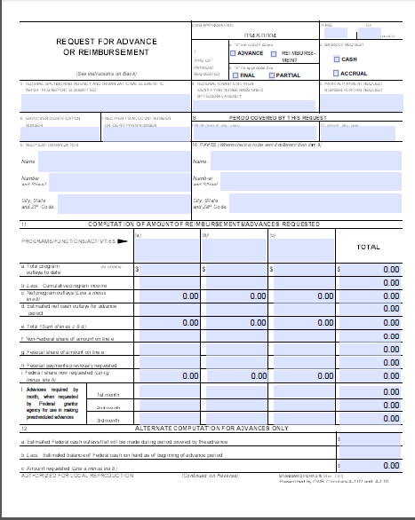
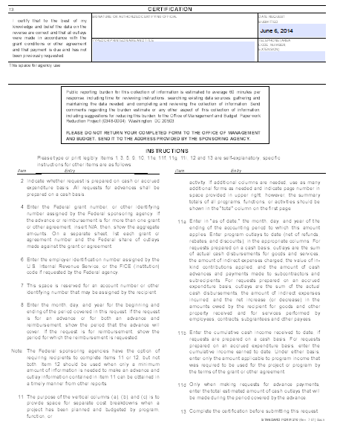
Supporting documentation
Performers are required to submit a signed SF-270 which can be found at the following link: https://www.sba.gov/sites/default/files/files/sf270(6).pdf
Make sure the amount requested on the SF-270 matches the amount requested in VIPERS AND the supporting documentation submitted
…or the invoice will be rejected
Sign AND date before submitting the SF-270 to VIPERS and ARPA-E

Slide 15
Supporting documentation (continued)
In addition to the SF-270, the following supporting documentation should also be submitted:
Categorized invoice on organization letterhead
ARPA-E invoice template / Reimbursement Request Spreadsheet or similar
Labor: Documentation showing total hours worked by labor category/personnel title and labor rate, including an explanation for any labor rates that are significantly different than those from the approved budget justification
Supplies: A list of supplies purchased and receipts for all large dollar purchases
Equipment: Receipts/invoices for all equipment purchases
Contractual: Invoices for all contractual services, including documentation of any cost share amounts contributed.
Budget Justification cost categories must be clearly outlined on invoice supporting documentation along with the line item expenses that total the category invoice amount
Travel: An expense report/ summary that indicates the business purpose and itinerary for each trip and receipts for all travel expenses over $75
Other Direct Costs: Receipts/invoices for all large dollar ODCs and documentation to justify any business meal expenses
Technology Transfer and Outreach: Supporting documentation broken out by Personnel, Travel, Supplies, Equipment, Contractual, and ODCs using the same criteria as above
Additional information can be found in Attachment 1 of the Cooperative Agreement.

Slide 16
Helpful invoice preparation hints
Compare the SF-270 Federal share and cost share amounts with their supporting documentation and make certain they match
Ensure the math is correct
Do not include personally identifiable information (PII)
Where required, submit evidence of prior approval by the ARPA-E Contracting Officer for costs incurred, including
Foreign travel not included on the approved budget
If invoicing for amounts previously claimed but not reimbursed:
Crosswalk between the original short-paid invoice and the current request for payment
Provide necessary documentation
There needs to be a strong correlation between the invoice and project performance as well as consistency with the approved budgeted costs
Pre-award costs exceeding FOA limits

Slide 17
Helpful invoice preparation hints (continued)
Examples of travel-related expenses disallowed by ARPA-E
Excess per diems/ Per diem amounts for incorrect locations
Family member travel
In-room movies
Spa treatments
Upgrades of any kind (hotel rooms, rental cars, flights, “priority access”, “extra legroom”)
“No show” penalties
Foreign travel that has not been pre-approved by the agency or in the approved budget justification
Child seats for a rental car
Meals for “Guests” (including spouses, coworkers not on travel, subcontractors, etc.)
Travel insurance
Temporary housing
Entertainment expenses / “Team Dinners”
Self-certification/ approval of travel overages
Additional costs incurred changing travel plans to leave early/ for family reasons, etc.
Alcoholic Beverages

Slide 18
Helpful invoice preparation hints (continued)
Other costs that ARPA-E has disallowed and may not be claimed
Personnel
Incentive compensation outside of total compensation/ established policy
New “Key Personnel” that has not received prior approval from the Program Director
Self-certified timesheets
Equipment & Supplies
Photographs of purchased items or quotes in lieu of actual invoices/ receipts
Equipment already owned by the Recipient
General purpose equipment without ARPA-E Contracting Officer prior approval
Depreciation on equipment purchased with federal funds
Other Direct Costs
Excessive recruitment or relocation costs
Local meals, happy hours, catered meals outside of strict business meeting criteria
Training, unless approved by CO/ PD in advance
Salaries and wages exceeding $200,000 per year per individual
Contractual labor claimed as direct labor costs
Incentives paid on a contingent basis (e.g., award of cooperative agreement by ARPA-E)

Slide 19
Contacts and Information Links
Tracking Invoices
Staff Who Can Help
Key Contacts
Guideline Links

Slide 20
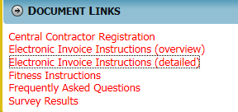
How do I track my invoice?
Click on Electronic Invoice Instructions (overview) to see how to submit an invoice in VIPERS
Click:
Click on Electronic Invoice Instruction (detailed) for detailed instructions

Slide 21
Staff who can help
Federal Staff
Program Director
Is responsible for the administration of work, and may issue technical direction interpreting but not amending an award
Contracting Officer
Is the only individual with the authority to obligate funds, disallow costs, and amend an award. Contracting Officers may be assisted by Contract Specialists to accomplish their responsibilities
Support Contractors
Technical (Tech) SETA
Primary POC for technical questions
Performs analysis of equipment and supplies
Programmatic (PM) SETA
Primary POC for non-technical questions
Can help answer Performer questions
Performs programmatic analysis
Financial Analyst
Can help Performer with financial questions
Performs analysis for allowability and cost reasonableness
T2M Advisor
Works to inform, connect, and advocate in support of the commercial success of projects once a Project Team has identified a commercialization strategy

Slide 22
Key contacts
ARPA-E Procurement Director and Contracting Officer (CO)
Bart Bridwell
E-mail: Bart.Bridwell@hq.doe.gov
Phone: 202-287-1015
ARPA-E Associate Director for Finance
Hai Duong
E-mail: Hai.Duong@hq.doe.gov
Phone: 202-287-6583
ARPA-E Contracting general e-mail: ARPA-E-CO@hq.doe.gov
If questions arise, please direct them to the ARPA-E support team before submitting an invoice.

Slide 23
Guideline links
Award Type | Federal Regulation/Guidance | Links
Grants and Cooperative Agreements for “For-Profit Companies” | Federal Acquisition Regulations (FAR) Part 31.2 | http://www.acquisition.gov/Far/
Grants and Cooperative Agreements with Non-Profit Organizations¹, Educational Institutions², and other Governmental units³ | 2 C.F.R. § 200, Subpart E | http://www.ecfr.gov/cgi-bin/text-idx?tpl=/ecfrbrowse/Title02/2cfr200_main_02.tpl
FAQs : https://arpa-e.energy.gov/?q=faq/general-questions
For Grants and Cooperative Agreements with Non-Profit Organizations (Does not apply to colleges and universities) made prior to 26-Dec-2014, please refer to 2 CFR Part 230 (formerly OMB Circular A-122) http://www.gpo.gov/fdsys/granule/CFR-2012-title2-vol1/CFR-2012-title2-vol1-part230/content-detail.html
For Grants and Cooperative Agreements with Educational Institutions made prior to 26-Dec-2014, please refer to 2 CFR Part 220 (formerly OMB Circular A-21) http://www.gpo.gov/fdsys/granule/CFR-2012-title2-vol1/CFR-2012-title2-vol1-part220/content-detail.html
For Grants and Cooperative Agreements with State and Local Governments made prior to 26-Dec-2014, please refer to 2 CFR Part 225 (formerly OMB Circular A-87) https://www.govinfo.gov/app/details/CFR-2012-title2-vol1/CFR-2012-title2-vol1-part225

