Slide 1
Breakout Session: Resource Identification (Tuesday, April 4th at 1:00PM ET)

Slide 2
Resource Identification (Tuesday, April 4th at 1:00pm ET)
Reminder!!
If you haven’t taken the poll, please do so:
1. Go to:
www.menti.com
2. Type in the following code:
9739 9511

Slide 3
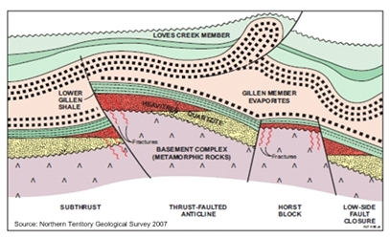
Finding the Resources
GEOLOGY
Identification of deposits
Fe(II) concentration
Permeability
Competent caprock
Please keep in mind that our focus is on finding mineral systems that can be stimulated to generate GeoH2
Natural accumulations may be indicators of a subsurface system
But, are not the sole target

Slide 4
What is stimulation in ARPA-e world
GEOLOGY
Identification of deposits
Fe(II) concentration
Permeability
Competent caprock
Changing the reaction rate
Shifting the equilibrium
Bypassing parasitic reactions

Slide 5
What are the Resources?
GEOLOGY
Identification of deposits
Fe(II) concentration
Permeability
Competent caprock
We use the simple examples of Fe(II) in olivine and/or fayalite
Oxidation of other metals?
Other mineral types with [FeO] >10%?

Slide 6
Question: 1
What order of magnitude deposit, in terms of H2 generation, should we be looking for?
1million tons?
10 million?
More

Slide 7
Question: 2
Are current state of the art technologies capable of discovering H₂ reserves on this (question 1) order of magnitude?
If not, what improvements or new technologies are required?

Slide 8
Question: 3
What exploration methods are most suitable for the discovery of economical geologic H₂ reserves (i.e. source rocks for H₂ stimulation or naturally occurring reserves)?

Slide 9
Question: 4
Are methods developed for exploration in other sectors (e.g. oil and gas, mining, geothermal) capable of predicting economic viability of H₂ reserves? If not, what improvements or new technologies would be required?

Slide 10
Question: 5
What downhole characterization is needed to identify economically viable reserves?

Slide 11
Question: 6
What functionality in downhole methods are missing from the State of the Art in regards to H₂ exploration? If gaps exist in todays downhole survey technology, how best can we overcome these shortcomings?

Slide 12
Question: 7
What other aspects of the “hydrogen system” (migration pathways, trap/seal, etc.) should be emphasized during the resource identification stage?

Slide 13
Question: 8
What exploration methods are needed to predict subsurface reactions resulting in the formation of H₂ (e.g. Fe(II) oxidation)?

Slide 14
Question: 9
What metrics would measure a meaningfully improved capability for identification of economically recoverable mineral-resource based stimulated hydrogen reserves?

