Slide 1
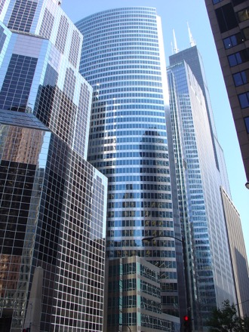
PERFORM Workshop June 17-18, 2019

Slide 2
ARPA-E Team
Dr. Jenny Gerbi, Assoc. Director of Technology, Program Director
Dr. Kory Hedman, Program Director
Dr. Joe King, Program Director
Dr. Scott Litzleman, Program Director
Dr. Ashley Arigoni,
TechSETA
Dr. Ray Duthu, TechSETA
Dr. David Guarrera,
TechSETA
Dr. Mirjana Marden, TechSETA
Max Tuttman, T2M Advisor
Richard Wilson,
T2M Advisor

Slide 3
Outline
A Modern Grid with Modern Management Systems
PERFORM Workshop Objectives and Program Status
The (tentative) PERFORM Program
Agenda

Slide 4
A Modern Grid with Modern Management Systems

Slide 5
If it works…
will it matter?

Slide 6
The U.S. Grid is Changing!
Intermittent Resources
New Operation
Flexible Loads
Distributed Resources
T&D Merging
Storage
New Planning
Grid modernization effort: Modern grid & emerging resources need modernization in decision support tools

Slide 7
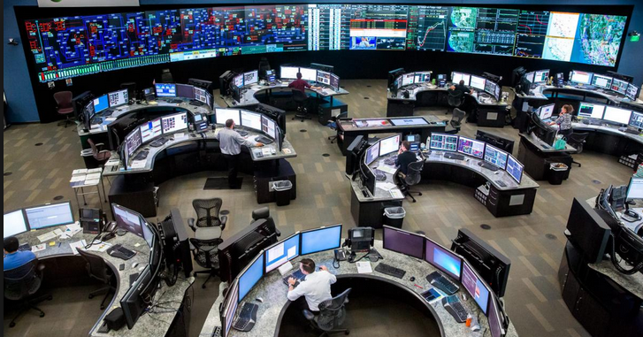
Grid Innovation
Future of Electric Power Systems
Resource flexibility
Quality of service
Decision Support / Management Systems
Risk management
Utilize ALL resources for all products and services
Scalability
Market Redesign
Risk-driven reform of electric energy markets
Transparent, fair evaluation of all asset offers

Slide 8
PERFORM Workshop Objectives and
Program Status

Slide 9
Workshop Objectives
Identify Innovative Risk and Performance-driven Operational and Planning Paradigms Consistent with Emerging Technologies
Define Path to Adoption
Bridge Diverse Communities Necessary to Tackle Key Challenges
PERFORM Program Scope and Metrics

Slide 10
ARPA-E Program Development & Execution
Project Handoff
Transition Toward Market Adoption
Ongoing Technical Review
EXECUTE
Program Conception (Idea/Vision)
ENVISION
PROGRAM DEVELOPMENT CYCLE
Workshop
Contract Negotiations & Awards
ESTABLISH
ENGAGE
Program Approval
Project Selection
EVALUATE
Funding Opportunity Announcement
Proposal Rebuttal
Merit Review of Proposals

Slide 11
Tentative Program Scope, Timeline, & Beyond
Year 1
Year 2
Year 3
Year 4
Year 5
Data
Synthetic
Data
Pilot
Site Data Collection, Processing, Analytics
Site Data
Site Data
R&D
8-10 Teams
R&D
Refine
R&D
Refine
R&D&D Finalize
Down Select: 3 Teams
Validation
Validation
Validation and Prediction
Down Select: 3 Teams
PERFORM R&D
Down Select 3 Pilots: 2 Small + 1 Medium/Large

Slide 12
Outreach and Engagement
We request: program design input
Feedback is key to improve the scope, focus, and goals of this tentative program
Potential Involvement:
Workshop: June 17-18, New York City
Data
Partner with potential teams
Pilot testing opportunity
Benefit:
Ability to influence and direct program relative to your current and future challenges
Funding opportunity

Slide 13
PERFORM Teams
Advanced tech
Asset / system modeling
Targeted pilot locations
Data / validation
POWER SYSTEMS
INDUSTRY
Risk metric
System risk assessment
Uncertainty quantification and valuation
Grid software
Optimization under uncertainty
FINANCE/
ACTUARIAL SCIENCE
OPERATIONS RESEARCH

Slide 14
The (tentative) PERFORM Program

Slide 15
Performance-based Energy Resource Feedback, Optimization, and Risk Management: PERFORM

Slide 16
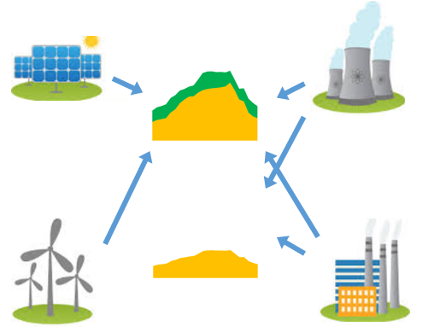
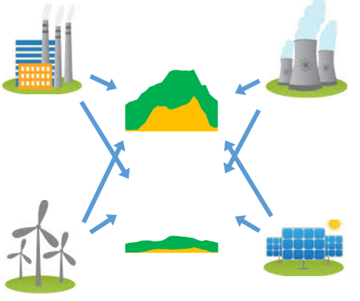
Paradigm Shift: Quantify Risk of Essential Reliability Services at Look-Ahead Time Stages
Existing paradigm
Future paradigm
Emerging assets
High risk offers
Conventional assets
Low risk offers
Energy
Energy
Ancillary Services
Ancillary Services

Slide 17
PERFORM Program Overview
Program Thrust 2
System Risk Assessment:
Risk-based Energy Management System (REMS) to balance collective risk across the grid
Program Thrust 1
Asset Risk Assessment:
A standardized, transparent risk score to gauge each asset’s relative performance
Tech to Market:
Pilot testing with utilities or ISOs willing to collect data and evaluate proposed software solutions to gauge program pursuits

Slide 18
Incorporating Risk Into Investments
Thrust 1: Asset Risk Assessment
Improved Frontier
Tech To Market: (Feedback Mechanism)
Thrust 2: System Risk Assessment
Current Evaluation: Risk not Quantified
Efficient Frontier
Value – Cost Ratio
1.0
0.9
Compliment with New Tech
Chosen Portfolio
Improve Forecasts
0.8
Deploy more often as base-load
0.7
Chosen Portfolio
Advance Technology
Onshore Wind Assets
0.6
PV-Solar Assets
Combined Cycle Assets
Nuclear Assets
0.5
Risk
Value-Cost Ratio is used as a proxy for “Return” and is defined by the EIA as the ratio of
Levelized Avoided Cost of Electricity (LACE) to Levelized Cost of Electricity (LCOE).
Sample values derived from: https://www.eia.gov/outlooks/aeo/pdf/electricity_generation.pdf

Slide 19
Incorporating Risk into Operations
% Renewable Penetration
1
2
3
4
1
0
2
3
4
5
6
7
8
9
Change Operations:
Allow renewables to make firm / non-firm / ancillary offers supported by well-founded risk analysis
Existing Rule:
Treat as must-take energy or curtail
Value – Cost Ratio
Convert to Ancillary Backup during daytime hours
1.0
Risk Balanced Operations
0.9
Starting Portfolio
With 15% Renewables
0.8
Reduce need for conventional asset backup
0.7
Constrained Operations
Onshore Wind Assets
0.6
PV-Solar Assets
Combined Cycle Assets
Begin shuttering older plants
Nuclear Assets
0.5
Risk
Value-Cost Ratio is used as a proxy for “Return” and is defined by the EIA as the ratio of
Levelized Avoided Cost of Electricity (LACE) to Levelized Cost of Electricity (LCOE).
Sample values derived from: https://www.eia.gov/outlooks/aeo/pdf/electricity_generation.pdf

Slide 20
Traditional Reliability with Conventional Assets
Traditional Risk Management with Conventional Assets
P[ΔMW]
Plant A
P[ΔMW]
Plant B
P[ΔMW]
Plant C
P[ΔMW]
Plant D
Renew A
“All or Nothing”
Chance of failure at each asset
P[ΔMW]
Variable Generation on a Small Asset
ΔMW
ΔMW
ΔMW
ΔMW
ΔMW
Conventional assets can secure system
with N-1 policy
Not part of security policy
Manage with Regulation
System Risk
P[MW Deviation]
Manage with Cont. Reserves
Chance of Cascading Failure and Blackout
MW Deviation
(Offers – Deliveries)

Slide 21
Traditional Reliability with Conventional Assets
Traditional Risk Management with Conventional Assets
P[ΔMW]
Plant A
P[ΔMW]
Plant B
P[ΔMW]
Plant C
P[ΔMW]
Plant D
Renew A
“All or Nothing”
Chance of failure at each asset
P[ΔMW]
Variable Generation on a Small Asset
ΔMW
ΔMW
ΔMW
ΔMW
ΔMW
Conventional assets can secure system
with N-1 policy
Not part of security policy
Renew A
70
System Risk
60
Manage with Regulation
Plant A
500
P[MW Deviation]
Manage with Cont. Reserves
Plant B
180
Plant C
350
Unexpected Plant Failure
Chance of Cascading Failure and Blackout
600
Plant D
0
Expected
Delivered
MW
Load
0.93
Sufficient Reserves with Conventional Assets
Avoid Failure
Available
System Gen.
1.09
1.70
MW Deviation
(Offers – Deliveries)
Expected
Delivered
GW

Slide 22
Traditional Reliability with Increasing Renewables
Traditional Risk Management with Conventional Assets
and Intermittent Renewables
P[ΔMW]
P[ΔMW]
Renew A
P[ΔMW]
Renew B
P[ΔMW]
Renew C
P[ΔMW]
Plant A
P[ΔMW]
Plant B
P[ΔMW]
Plant C
Plant D
Renew A
ΔMW
Variable Generation on a Small Asset
“All or Nothing”
Chance of failure at each asset
ΔMW
P[ΔMW]
ΔMW
P[ΔMW]
Renew D
P[ΔMW]
Renew E
P[ΔMW]
Renew F
ΔMW
ΔMW
ΔMW
ΔMW
ΔMW
ΔMW
ΔMW
ΔMW
Fewer conventional assets to secure N-1
Renewables use
must-take or curtail policy
Renew A
60
Delivery from renewables does not match prediction
Renew A
70
System Risk
Renew B
70
120
Manage with Regulation
100
Renew C
90
Forced
Curtailment
Plant A
150
500
Probability
Renew D
25
40
Renew E
160
Plant B
130
Manage with Cont. Reserves
Renew F
110
180
90
Plant A
500
Unexpected Plant Failure
Chance of Cascading Failure and Blackout
Plant C
350
Plant B
180
Plant C
Retired -- Displaced by Renewable Capacity
Plant D
600
Plant D
600
0
Delivered
Expected
MW
Load
0.93
Insufficient Conventional Reserves
High Risk at N-1
Available
System Gen.
1.25
1.70
MW Deviation
(Offers – Deliveries)
1.86
Expected
Delivered
GW

Slide 23
Reliability with Risk-Based Management System
Performance-Based Risk Management over All Assets
P[ΔMW]
P[ΔMW]
P[ΔMW]
P[ΔMW]
Renew A
P[ΔMW]
Renew B
P[ΔMW]
Renew C
Plant A
Plant B
Plant D
ΔMW
ΔMW
ΔMW
P[ΔMW]
Renew D
P[ΔMW]
Renew E
P[ΔMW]
Renew F
ΔMW
ΔMW
ΔMW
ΔMW
ΔMW
ΔMW
Balanced risk policy
that incorporates renewables
Split Into Firm and Non-Firm Offers
Renew A
60
Renewable firm offers are portion of total predicted service with a very high reliability of delivery
60
70
Manage with Regulation
System Risk
Renew B
120
100
120
Renew C
90
Forced
Curtailment
90
150
Probability
Renew D
25
25
40
Renew E
160
130
160
Manage with Cont. Reserves
Renew F
110
110
90
Plant A
500
Unexpected Plant Failure
Chance of Cascading Failure and Blackout
Plant B
180
Plant C
Retired -- Displaced by Renewable Capacity
Plant D
0
600
Delivered
Expected
MW
Avoid Failure
Sufficient Reserves with Firm Offers from Mix of Assets
Load
0.93
Increase Firm Capacity
Available
System Gen.
1.25
1.86
MW Deviation
(Offers – Deliveries)
Expected
Delivered
GW

Slide 24
Agenda

Slide 25
Monday Morning Agenda
Jessica Harrison, Director of Research and Development,
Midcontinent Independent System Operator (MISO)
Mahesh Morjaria, VP of PV Systems Development,
First Solar
Breakout Session 1: Towards Industry Adoption
Lunch

Slide 26
Workshop Objectives
Identify Innovative Risk and Performance-driven Operational and Planning Paradigms Consistent with Emerging Technologies
Define Path to Adoption
Bridge Diverse Communities Necessary to Tackle Key Challenges
PERFORM Program Scope and Metrics

Slide 27
We seek your feedback and input!
Kory W. Hedman
Program Director
Advanced Research Projects Agency – Energy (ARPA-E)
U.S. Department of Energy
Kory.Hedman@hq.doe.gov

