Slide 1
Breakout Session: Stimulation (Wednesday, April 5th at 1:00PM ET)

Slide 2
Stimulation (Wednesday, April 5th at 1:00pm ET)
Reminder!!
If you haven’t taken the poll, please do so:
1. Go to:
www.menti.com
2. Type in the following code:
9739 9511

Slide 3
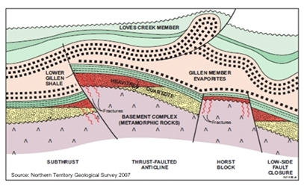
Finding the Resources
GEOLOGY
Identification of deposits
Fe(II) concentration
Permeability
Competent caprock
Please keep in mind that our focus is on finding mineral systems that can be stimulated to generate GeoH2
Natural accumulations may be indicators of a subsurface system
But, are not the sole target

Slide 4
What is stimulation in ARPA-e world
CHEMISTRY
Reaction conditions
Kinetics
Catalysis
Biology
Changing the reaction rate
Shifting the equilibrium
Bypassing or suppressing parasitic reactions
Fe (II) + H₂O Fe (III) oxides and H₂

Slide 5
What are the Resources?
CHEMISTRY
Reaction conditions
Kinetics
Catalysis
Biology
We use the simple examples of Fe(II) in olivine and/or fayalite
Oxidation of other metals?
Other mineral types with [FeO] >10%?
Fe (II) + H₂O Fe (III) oxides and H₂

Slide 6
Question: 1
What leads you to believe serpentinization can be economically enhanced to produce H₂?

Slide 7
Question: 2
What stimulation approaches should be considered for enhancing the productivity of mineral-based hydrogen resources? (chemical, mechanical, biological, thermal, other)

Slide 8
Question: 3
What are the limiting factors to stimulating H₂ production?

Slide 9
Question: 4
How would you determine the potential yield from stimulation methods?

Slide 10
Question: 5
Are there other reactions besides serpentinization that are potentially relevant to H₂ production? What different reaction conditions would be needed?

Slide 11
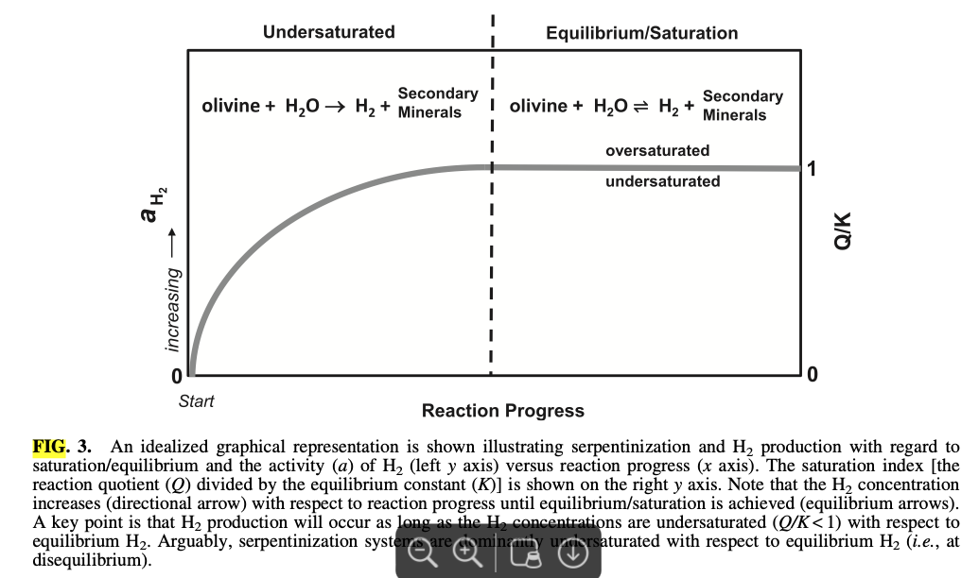
Question: 6
How does the amount/concentration of H₂ in the reservoir influence the rate of serpentinization stimulation?
ASTROBIOLOGY Volume 15, Number 7, 2015

