Slide 1
A Micro-Systems Enabled Transformation in PV
Michael Haney, Ph.D.
Program Director

Slide 2
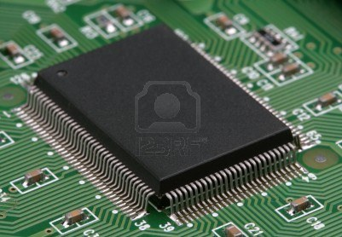
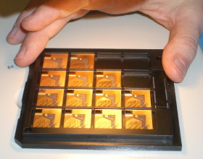
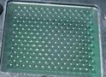
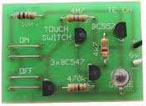
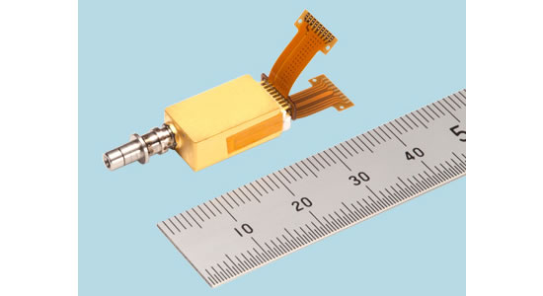
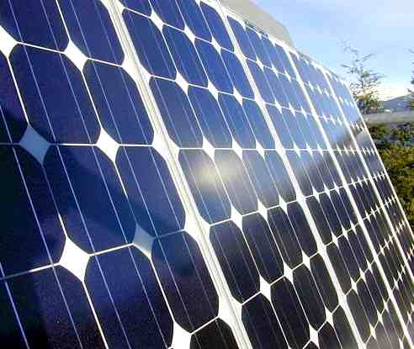
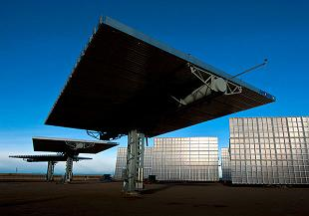
As in Electronics and Photonics, can PV can be transformed by exploiting micro-systems technologies?
Micro-electronics Integrated Circuit
Micro-photonics
Integrated Circuit
“Micro-helionics”
Integrated Circuit ??
Increasing
Ops/J
Increasing
BW density/J
Increasing
J/$, J/kg
Increasing Complexity
Discrete Transistor circuit
Discrete laser/mod/detect circuit
Discrete PV and CPV “circuits”
  It’s all about the Packaging: micro-scale technology provides an effective interface between the macro collection and nano conversion domains.

Slide 3
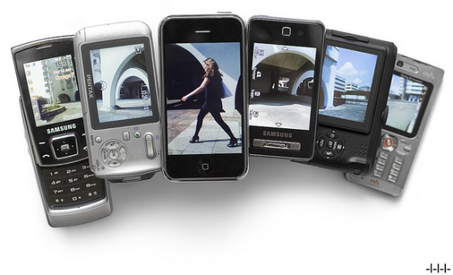
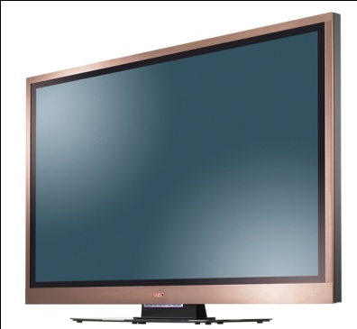
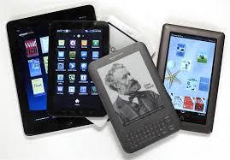
Existence proof: Large-area integrated micro-optical/ photonic/electronic systems already exist as commodities
Examples
TFT/LCD displays at 1080p LCD pixels are $500/m²
Touch screen displays for phones, tablets, e-books
FP displays have higher complexity relative to envisioned μ-CPV panels
TFT/LCD panels have ~10⁷/m², 3 color,8-bit active pixels, with 100% yield.
Anticipated μ-CPV will have ~10⁵/m², ~4-6 “color,” DC pixels, with 99% yield.
Can we exploit micro-scale complexity to drive micro-CPV prices to ~$100’s/m²?

Slide 4
Potential Scaling Benefits for μ-CPV 1
Micro-optics mass scaling factor
  Reducing height by factor of N and replacing macro-concentrator with N² micro-concentrators that have the same collection area reduces overall mass by N.
  Micro-optics performance scaling
    Smaller lenses work better and are easier to fabricate.*
Replace one macro-optical concentrator
With N² micro-optical concentrators
N
*A. Lohmann, Applied Optics, Vol. 28, No. 23, December, 1989

Slide 5
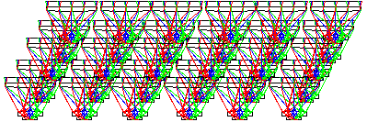
Potential Scaling Benefits for μ-CPV 2
Thermal management benefits
  Total cell perimeter-to-area ratio scales with N.
Temperature
Nielsen, et al., Fut. PV, May 2010;

Slide 6
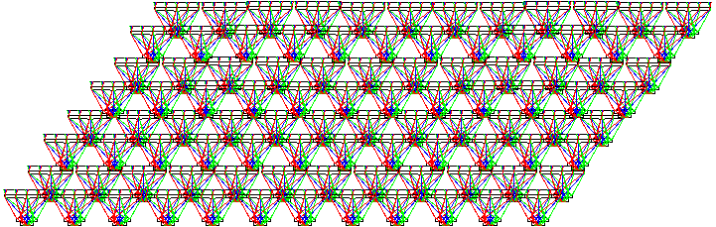
Potential Scaling Benefits for μ-CPV 3
  Access to wider angular spectrum
    Easier (cheaper) to approach Etendue limit (C_{max} = n²/sin²α) with micro-optics.
      Cheaper and energy efficient (low mass) collection and tracking options
    Also possible to achieve more concentration of low-angle diffuse light
    Performance improvement of ~0.4-2.3% is possible by increasing acceptance angle from 2º to 5º.*
α
*G. Agrawal, et al, PVSC 2013

Slide 7
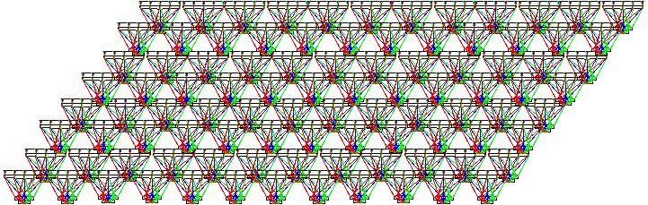
Potential Scaling Benefits for μ-CPV 4
Interconnect diversity leads to optimized current matching and voltage summing
    Voltage matching provides ~3% improved power conversion efficiency over current matching.*
*A. Lentine, et al, PVSC 2013

Slide 8
Micro-scale Technical Approach Opportunities
  Better Energy Spectrum Management?
    Integrated spectrum-splitting and concentration concepts.
    Hybrid tandem/lateral concepts.
    Optimized (real-time?) spectrum/electrical power matching.
  Better Angular Spectrum Management?
    Wide-angle low- or medium-concentration concentrator optics.
    Hybrid μ-CPV/PV may combine high-efficiency direct and lower-efficiency diffuse energy harvesting.
  Embedded Micro-tracking?
    Various actuation techniques may be considered, depending on architecture.
    Automatic tracking based on micro-scale physics?
Can we exploit these performance scaling benefits AND achieve cost scaling benefits?

Slide 9
Seattle | Portland | Detroit | Chicago | New York City | Boston | Wilmington | Minneapolis | New Orleans | Atlanta | Miami | Tampa | San Francisco | Los Angeles | Boulder | Honolulu | Fresno | Grand Junction | Reno | Flagstaff | Tonopah | Prescott | Albuquerque | Phoenix | Tucson | Las Vegas | Dagget
Data from: Christian A. Gueymard, Proc. of SPIE Vol. 7046
Annual Average Global Solar Radiation on a 2-axis tracking system per day (kWh/m²-day)

Slide 10
Seattle | Portland | Detroit | Chicago | New York City | Boston | Wilmington | Minneapolis | New Orleans | Atlanta | Miami | Tampa | San Francisco | Los Angeles | Boulder | Honolulu | Fresno | Grand Junction | Reno | Flagstaff | Tonopah | Prescott | Albuquerque | Phoenix | Tucson | Las Vegas | Dagget
Data from: Christian A. Gueymard, Proc. of SPIE Vol. 7046
Annual Average Global Solar Radiation on a 2-axis tracking system per day (kWh/m²-day)

Slide 11
Projected CPV
domain
Seattle | Portland | Detroit | Chicago | New York City | Boston | Wilmington | Minneapolis | New Orleans | Atlanta | Miami | Tampa | San Francisco | Los Angeles | Boulder | Honolulu | Fresno | Grand Junction | Reno | Flagstaff | Tonopah | Prescott | Albuquerque | Phoenix | Tucson | Las Vegas | Dagget
Data from: Christian A. Gueymard, Proc. of SPIE Vol. 7046
Annual Average Global Solar Radiation on a 2-axis tracking system per day (kWh/m²-day)

Slide 12
Performance/Cost White-Space Chart for Solar PV
1.2x10⁴
20 kWh/$
Tucson
Reno
Los Angeles
Minneapolis
Portland
μ-CPV potential
Straw man capabilities
35% module eff. (global radiation)
Module cost per m² same as 1-sun (i.e., 2x less in $/W_{p})
50% of BOS cost ~ installed footprint→ 25% lower $/m²
  Res. Rooftop → ~$1/W
50% increase in constrained-space PV market
10⁴
10 kWh/$
Comm.
Tucson
Reno
Utility
CPV, ~40% eff.
(direct radiation)
Commercial
Residential
8x10³
Current CPV (est.)
6x10³
20-year energy production density (kWh/m²)
Tucson
Reno
Los Angeles
Minneapolis
Portland
Utility
Commercial
4x10³
Residential
2015 1-sun PV (proj.)
1-Sun PV, 20% module eff.
(global radiation)
2x10³
1000 750 500 250
Solar Cell System Cost Density ($/m²)

Slide 13
Performance/Mass White-Space Chart for Solar PV
Can we break this paradigm by integrating micro-concentrators and micro-PV cells tiled in dense, flat arrays?
** Max. performance limit
500
1000 sun/ 6 junctions
** 6 junction/ 25 suns perf. limit
400
VHESC Phase III goal
μ-CPV
Target Region
Av. Power Density Delivered* (W/m²)
300
**Single junction, 1 sun perf. limit
CdTe projected
200
CIGs
400 W/Kg
Smaller Footprint
Si roof top
100
Lower Mass
Polymer projected
PowerfilmTM
** Thermodynamic limit de-rated by 67% to account for practical engineering constraints
100 10 1 .1
Solar Cell Mass Density (Kg/m²)
*Over peak 6 hour period of sunlight
There seems to be a trade-off between performance (energy capture) and system mass

Slide 14
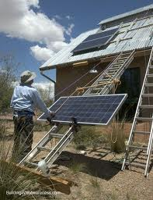
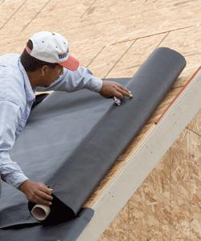
What if micro-CPV made it this simple?
Conventional PV
μ-CPV
Sample metric | Value
BOS (normalized) | 1
Global Efficiency | 20%
Installed Cost | >1.50 $/W
W/Mass | 200 W/Kg
Sample metric | Value
BOS (normalized) | 3/4
Global Efficiency | 35%
Installed Cost | ~1.00 $/W
W/Mass | 400 W/Kg
Technology disruption does not follow trend lines of current metrics.

Slide 15
The Heilmeier Questions
For this workshop….
What are the critical challenges?
2. How is it solved today?
3. What is the new technical idea; why can we succeed now?
4. What will be the impact if successful? (Who cares?)
5. How will the program be organized?
6. How will intermediate results be generated?
7. How will you measure progress?
8. What will it cost and how long will it take?
What is the problem, why is it difficult?
2. How is it solved today?
3. What is the new technical idea; why can we succeed now?
4. What is the impact if successful?
5. How will the program be organized?
6. How will intermediate results be generated?
7. How will you measure progress?
8. What will it cost and how long will it take?

Slide 16
Straw man Goals
~1.75x improvement in flat panel efficiency: 35% of global radiation
~1.75x improvement in panel cost/Watt (maintain cost/area)
Reduce BOS costs by >25%
Expand constrained-space PV market by ??%
  Residential rooftop?
  Commercial?
  Transportation?
  Military?
  Space?
  Other?
What are the most appropriate metrics?
Are these goals legitimate? If not, what should they be?

Slide 17
Agenda: Thursday, May 8
8:00 AM– 9:00 AM Registration and Breakfast
9:00 AM– 9:15 AM Welcome and Opening Remarks Dr. Eric Rohlfing
9:15 AM– 9:45 AM Workshop Background & Objectives Dr. Mike Haney
9:45 AM– 10:15 AM “Solar Cell Market Evolution
Can we predict the next wave of innovation?” Dr. Jim Rand
10:15 AM– 10:30 AM Coffee Break
10:30 AM–11:00 AM “Exploiting scale effects in photovoltaic cells,
modules, and systems” Dr. Greg Nielson
11:00 AM–11:30 AM “From Novelty to Ubiquity: Challenges & Strategies of
Scaling the LCD Platform” Dr. Pete Bocko
11:30 AM-12:00 PM “An Overview of DoD Military Energy Needs” Ms. Sharon Beermann-Curtin
12:00 PM-12:15 PM Introduction to Breakout 1 Dr. Mike Haney
12:15 PM- 1:15 PM Working Lunch, Breakout 1 (seating by breakout group)
1:15 PM- 2:30 PM Breakout 1, Continued
2:30 PM- 3:00 PM Break
3:00 PM - 4:15 PM Breakout 1, Continued
4:15 PM - 4:30 PM Break
4:30 PM - 5:30 PM Presentation of Breakout 1 Reports by Session Moderators
5:30 PM - 7:30 PM Optional: 15 minute sidebars with Dr. Haney by appt. (sign up with Colleen)

Slide 18
Agenda: Friday, May 9
7:30 AM- 8:30 AM Breakfast
8:30 AM- 8:45 AM Day 2 Welcome, Breakout 2 Introduction
8:45 AM- 10:00 AM Breakout 2
10:00 AM- 10:30 AM Break
10:30 AM-12:00 PM Breakout 2, Continued
12:00 PM- 1:30 PM Lunch and Presentation of Breakout 2 Reports by Session Moderators
1:30 PM- 2:30 PM Closing Remarks and Open Discussion of Workshop Findings.
2:30 PM- 4:30 PM Optional: 15 minute sidebars with Dr. Haney by appt. (sign up with Colleen)

